Slide 1
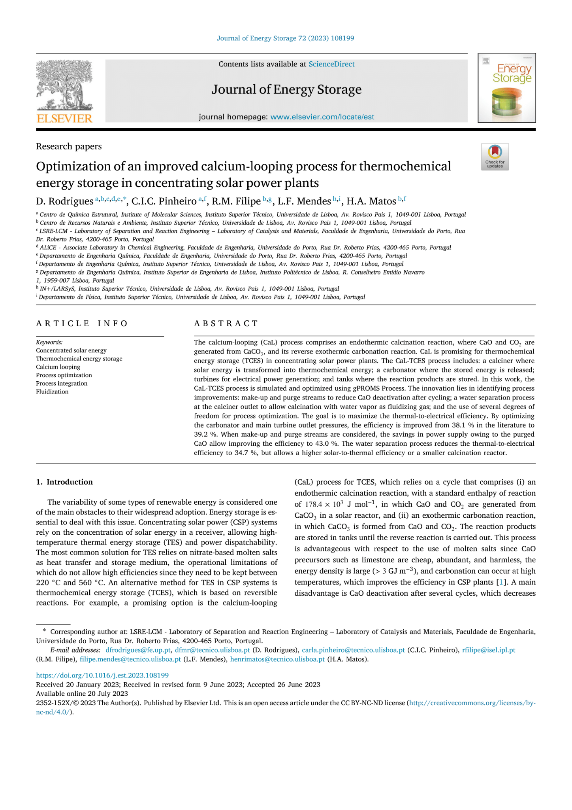

Optimization of an improved calcium-looping process for thermochemical energy storage in concentrating solar power plants
Date - 05 - 09 - 2023
Rohit Chalak: 210107073
Dnyanesh Bhole: 210107019
Govind Madhav Vyas: 210107031
Mrityunjay Sharma: 210107054
Group - 5

Slide 2
Content
Introduction.
Process of modelling and optimisation.
Results and Discussion.
Conclusions

Slide 3
Introduction
1

Slide 4

Introduction: Background
The research aims to optimize the Calcium-Looping (CaL) process for thermochemical energy storage in concentrating solar power plants.
The CaL-TCES process proposed by Ortiz is used as a benchmark and starting point for the simulation and optimization study.
The research introduces three innovative aspects: optimization of key variables, consideration of make-up and purge streams, and a proposed water separation process.

Slide 5
Introduction: Literature Comparisons
Literature Comparison | Literature Gaps
Optimization of carbonator and main turbine outlet pressures without purge or water separation process | Failed to consider the inclusion of make-up and purge streams for improved efficiency gains
Consideration of calcination under water vapor with optimal solids purge split fraction. | Failed to consider the detailed heat integration analysis and the tradeoff between thermal-to-electrical efficiency and solar-to-thermal efficiency.
Proposal of a water separation process for the use of water vapor in the solar calciner | Failed to consider the increase in residual conversion of CaCO3/CaO mixture and its effect on the overall efficiency

Slide 6
Goals and Objectives
Optimization of the carbonator and main turbine outlet pressures to improve thermal-to-electrical efficiency.
Study the effect of varying solids purge split fraction on the CaL-TCES process and its impact on efficiency.
Analyze the tradeoff between maximizing thermal-to-electrical efficiency and solar-to-thermal efficiency in the CaL-TCES process.

Slide 7
Process of modelling and optimisation
2

Slide 8
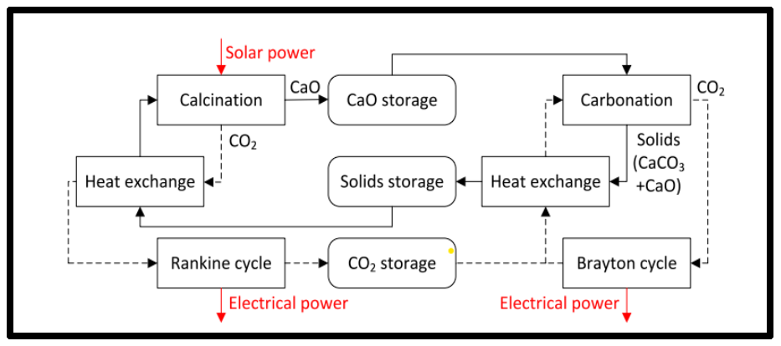
Schematic Diagram of the Process

Slide 9
CaL-TCES process
The CaL-TCES process involves a solar calciner (CALC) and a carbonator (CARB) that convert CaCO3 to CaO and CO2, and vice versa, respectively.
Turbines are used for electrical power generation, and tanks are used to store the reaction products.
Heat exchangers are employed to enable heat integration within the reactors.
When solar radiation is available, calcination occurs in the solar calciner, and CO2 is used to heat up solids and generate steam for power generation.
The carbonator side of the process operates continuously, while the calciner side operates only when solar radiation is available.

Slide 10
Description of the water separation process
The process aims to separate the gas outlet stream of the solar calcination reactor into two streams: one with a high fraction of water to be recycled and another with a high fraction of CO2.
The separation process should ensure that both outlet streams reach the same temperature and pressure as the gas outlet stream of the calcination reactor.
The proposed process includes multiple stages of unit operations, initial cooling, and final separation and heating steps.
Heat integration is utilized between condensation/cooling and evaporation/heating in each separation stage and between the initial cooling and final heating steps.
Compressors are used to increase the pressure of the vapor streams, and the pressure ratios in the compressors are the only available degrees of freedom in the separation process.

Slide 11
Optimization procedure
The goal of the study is to maximize the thermal-to-electrical efficiency of the CaL-TCES process while considering various constraints.
A nonlinear program (NLP) is used to optimize the process and achieve improved efficiency.
The study focuses on modifying the main turbine outlet pressure, carbonator outlet pressure, and conversion in the carbonator to maximize efficiency.
The inclusion of make-up and purge streams allows for energy savings and consideration of CaO leaving the process.
A process for water separation from the gas outlet stream of the calcination reactor is proposed to reduce calcination temperature and residence time, and the pressure ratios in the compressors are optimized to minimize power consumption.

Slide 12
Process configurations
Optimization of carbonator and main turbine outlet pressures without purge or water separation process, assuming 15% residual conversion in the carbonator and CO2 as the fluidizing gas in the calciner.
Introduction of a varying solids purge split fraction (fp) between 0 and 1, considering optimal carbonator and main turbine outlet pressures, CO2 in the calciner, and the purge split fraction.
Calcination under water vapor considered for the optimal value of fp in case (2), assuming equal mass flow rates of water vapor and solids at the calciner inlet. Efficiency penalty associated with the water separation process is also computed.

Slide 13
Results and discussion
3

Slide 14
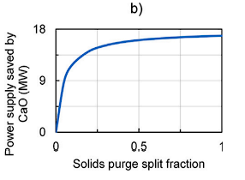
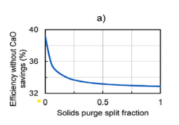
Optimization of the carbonator and main turbine outlet pressures
By changing the carbonator and main turbine outlet pressures from 3 bar and 1 bar to 1.485 bar and 0.293 bar respectively, the efficiency can be improved from 38.1% to 39.2%. This highlights the importance of optimizing these decision variables to enhance efficiency.

Slide 15
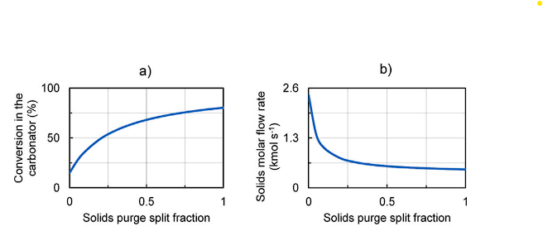
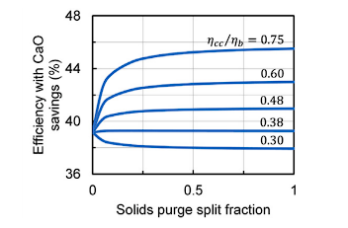
Effect of the solids purge split fraction
Raising the solids purge rate (𝑓𝑝) in the CaL-TCES process leads to a decrease in efficiency while resulting in power savings. The optimal 𝑓𝑝 value is contingent upon the efficiency ratio, with a maximum attainable efficiency of 43% under ideal conditions. As 𝑓𝑝 increases, the carbonator conversion rate rises, but the flow of solids decreases due to a higher proportion of CaCO3 being transformed into CaO

Slide 16
Effect of the water separation process
Increasing the solids purge split fraction (fp) from 0 to 1 can improve the efficiency (η2) of the process.
The exact improvement in efficiency depends on the efficiency ratio (ηcc/ηb) considered.
Without considering the savings from the CaO leaving the process in the solids purge (η1), the efficiency decreases from 39.2% to 32.9% as fp increases from 0 to 1.
However, the savings owing to the CaO leaving the process (Qp) increase from 0% to 16.9% of the solar input as fp increases from 0 to 1.
The best strategy is to set fp equal to 1 (without a recycle stream) if and only if the efficiency ratio (ηcc/ηb) is larger than 0.38. For ηcc/ηb = 0.60, the efficiency increases from 39.2% to 43.0%.

Slide 17
Conclusion
4

Slide 18
Conclusion
Water vapor as a fluidizing gas: The use of water vapor in the calcination process affects the residual conversion of the CaCO3/CaO mixture, which in turn impacts the conversion in the carbonator and the overall efficiency.
Efficiency improvement: The incorporation of water vapor leads to a significant increase in solar-to-thermal efficiency, resulting in a more efficient utilization of solar energy.
Smaller calcination reactor: By utilizing water vapor, it becomes possible to design a smaller calcination reactor. This not only saves space but also reduces costs associated with construction and materials.

Slide 19
Conclusion
Tradeoff between objectives: There is a tradeoff between maximizing thermal-to-electrical efficiency and maximizing solar-to-thermal efficiency. The use of water vapor for calcination optimizes the former objective while considering the latter.
Temperature considerations: The study also explores the effect of the water separation process at a lower calcination temperature of 800°C. It is found that the benefits of using water vapor, such as increased efficiency and savings, remain consistent even at this lower temperature.

